Slide 1
Angular 9

Slide 2
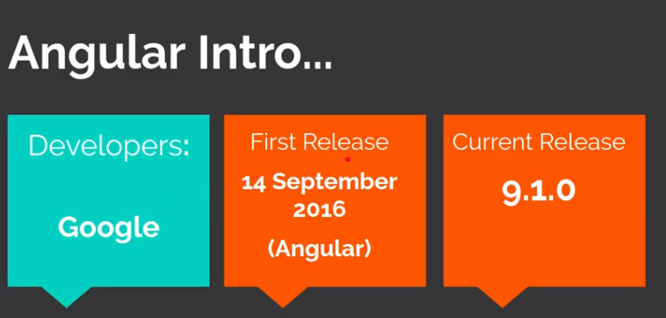

Slide 3
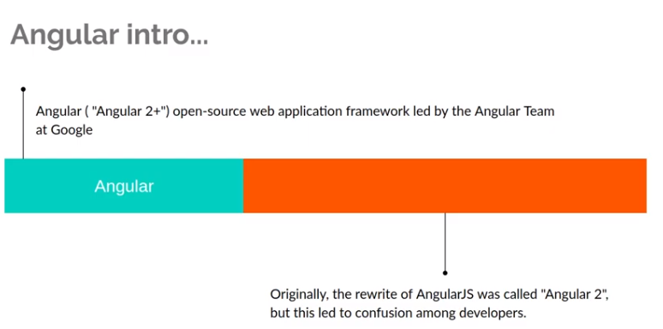

Slide 4
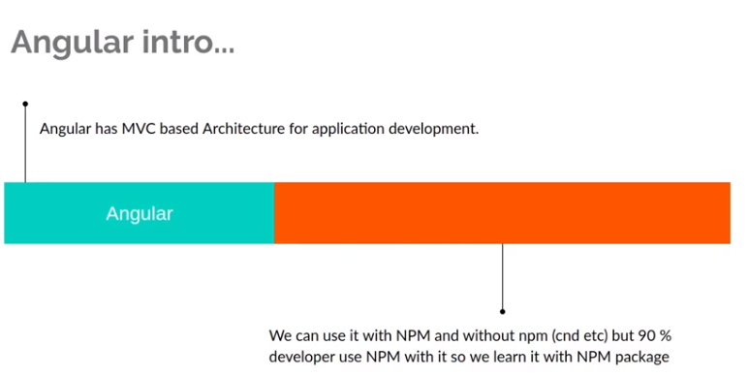

Slide 5
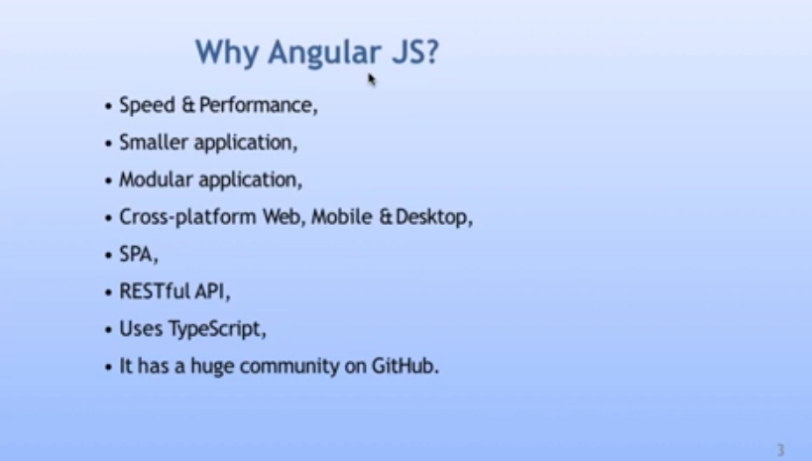

Slide 6
Install Angular 9
Node js & NPM Install
Type Script install
npm install -g @angular/cli
ng new angular
cd angular
ng serve -o

Slide 7
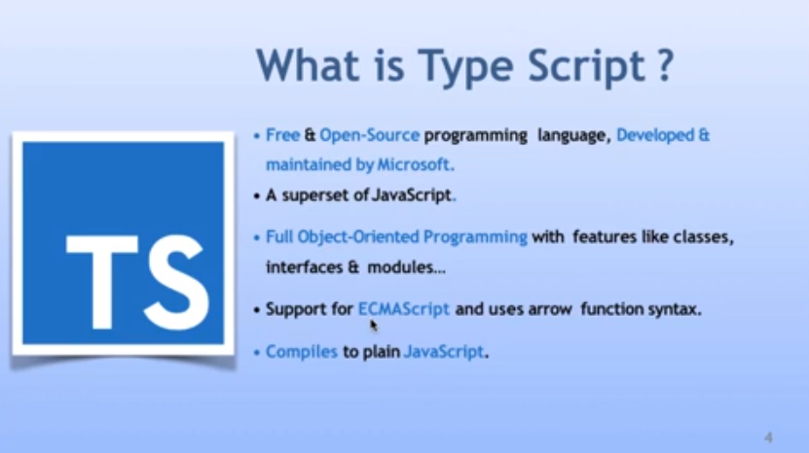

Slide 8
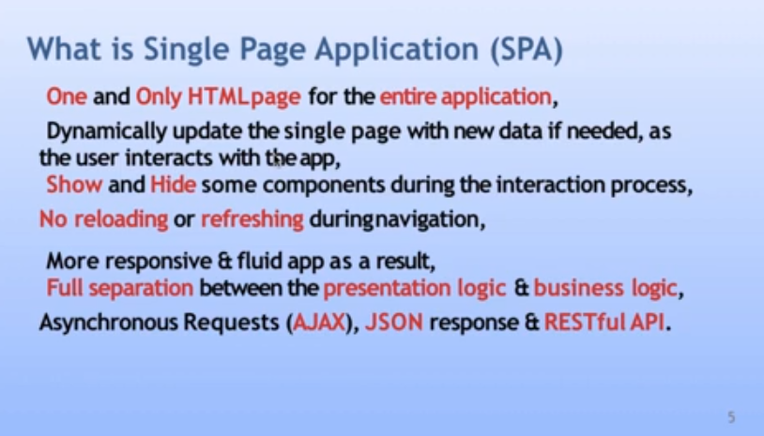

Slide 9
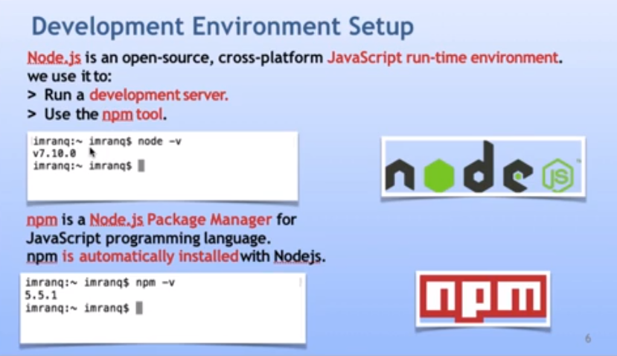

Slide 10
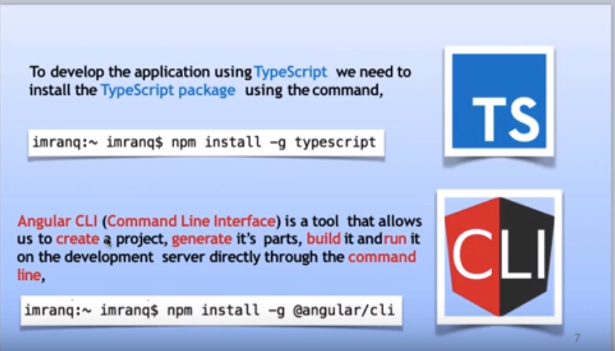

Slide 11
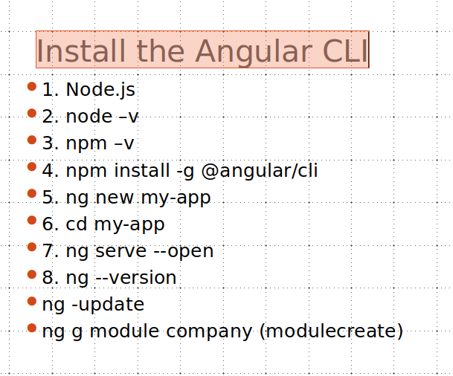

Slide 12
Add Bootstrap
npm install bootstrap jquery popper.js --save

Slide 13
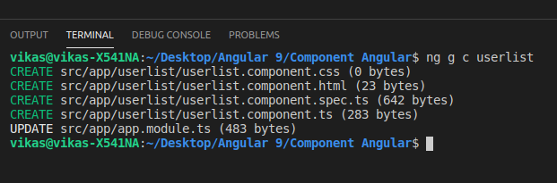
Component Angular 9
ng generate component xyz
Ng g c UserList

Slide 14
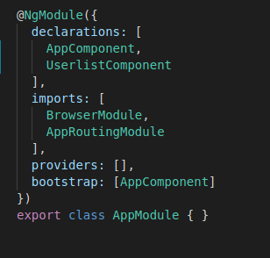
Module Angular 9
Module ek group hai chote chote commponet ka (user_module):--login_commpont,Reg

Slide 15

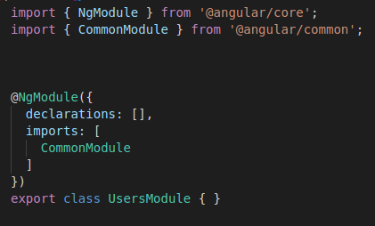
Module
Ng g module users
Ng g c users/login

Slide 16

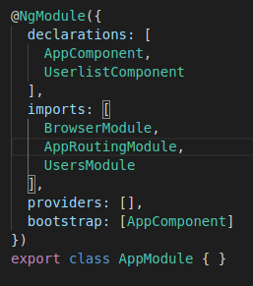
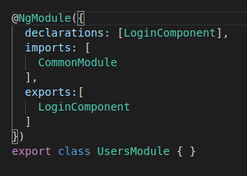

Ng g c users/login

Slide 17
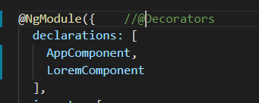
Decorators
Decorators

Slide 18
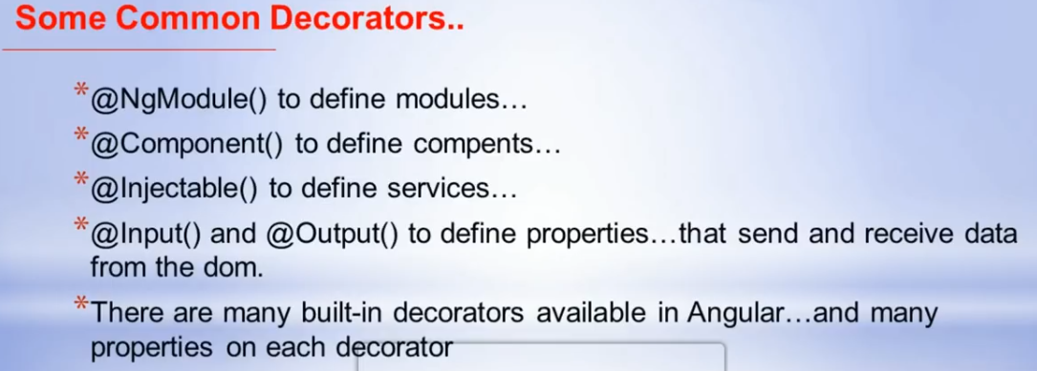

Slide 19
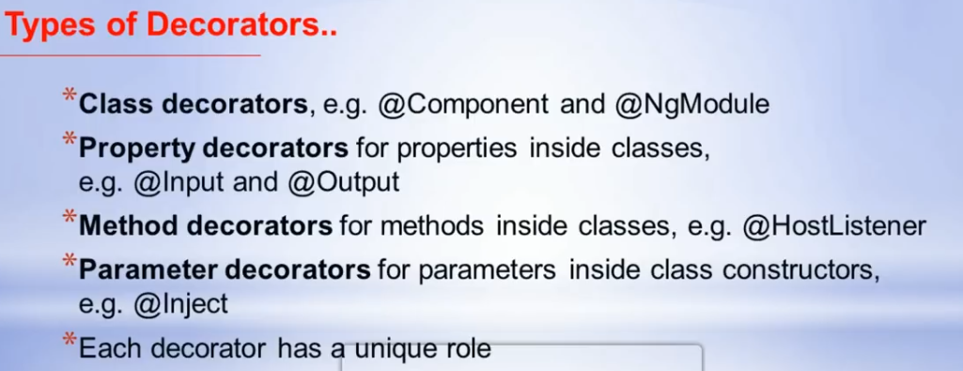

Slide 20
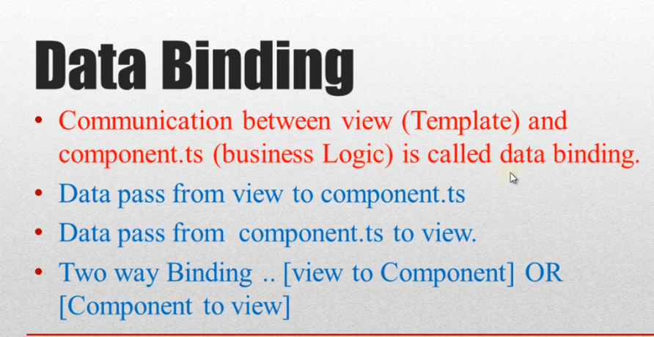

Slide 21
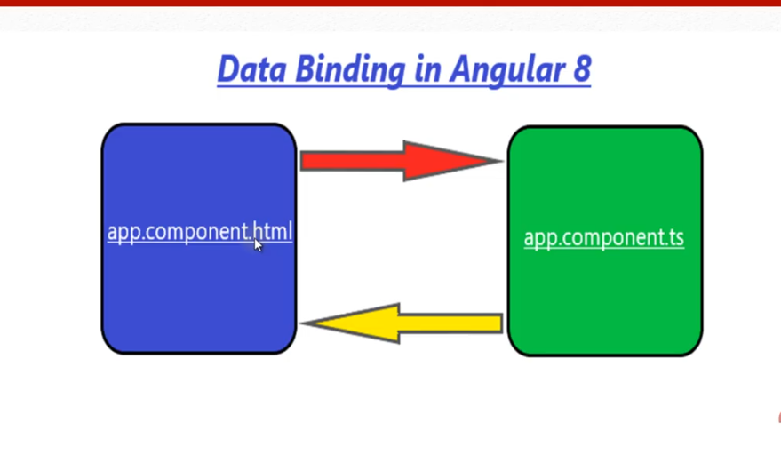

Slide 22
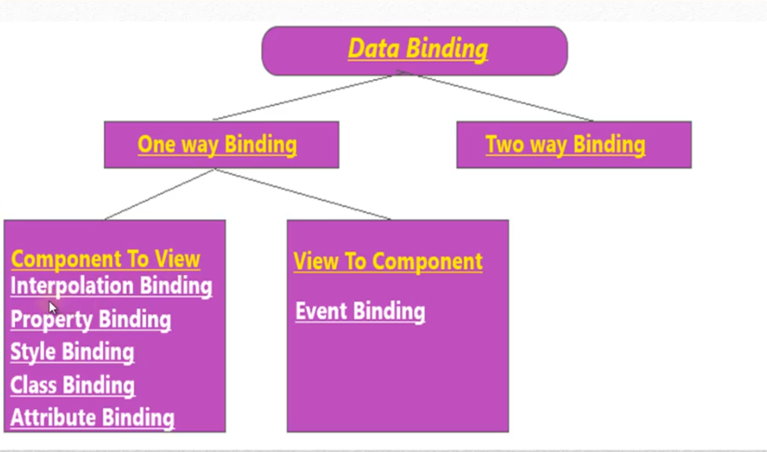

Slide 23
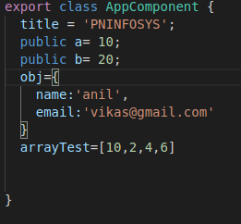
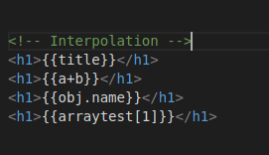
Interpolaion

Slide 24
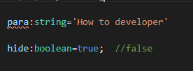

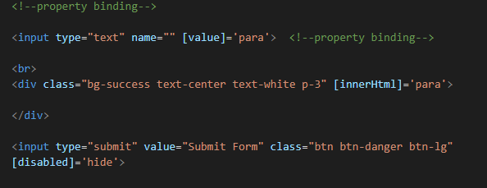
Property Binding

Slide 25
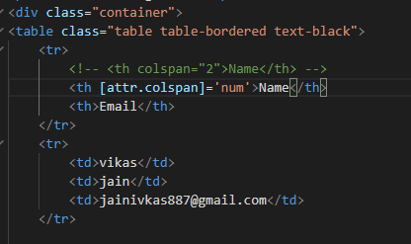
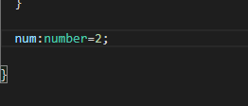
attributebinding

Slide 26
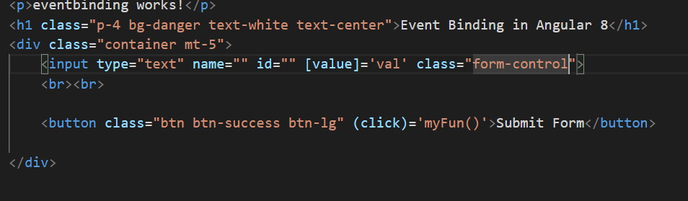
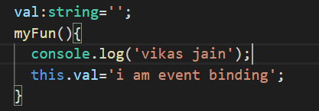
Event Binding

Slide 27
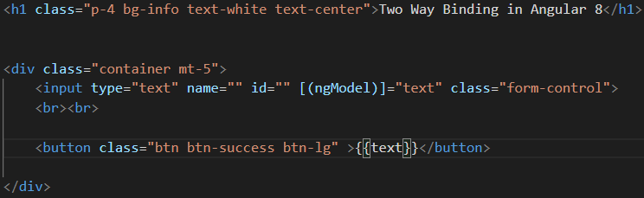
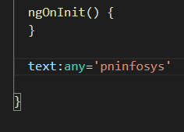
Two way Binding
import { NgModule } from '@angular/core';(ng module use formsmodule)
import { FormsModule } from '@angular/forms';

Slide 28
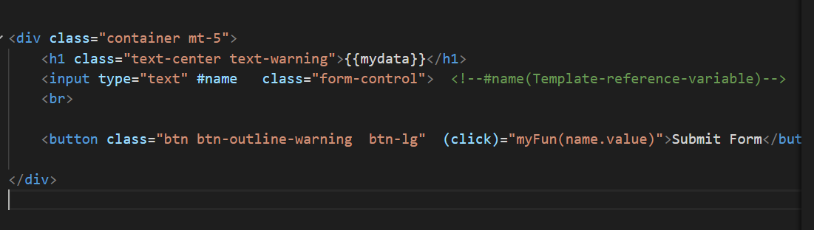
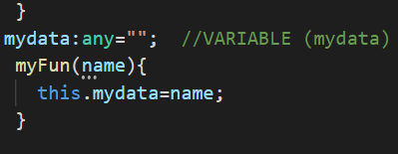
Template Reference varibale

Slide 29
Ng Style && Ng Class

Slide 30
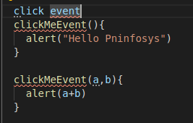

Click Event

Slide 31
Structural Directives
*ngif
*ngFor
*ngSwitch

Slide 32
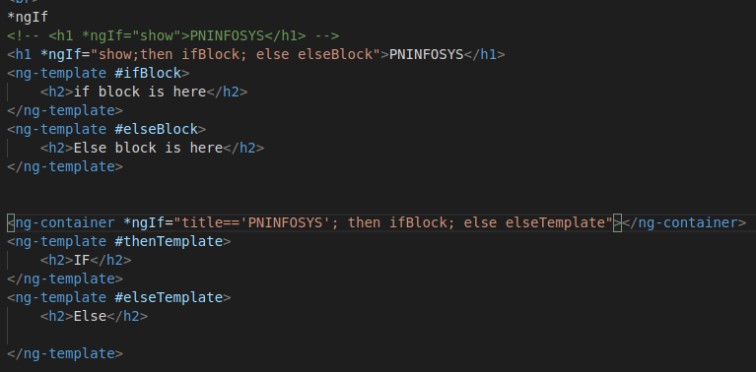
*ngIf

Slide 33
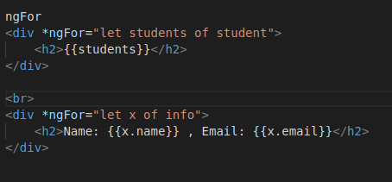
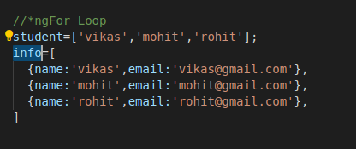
*ngFor

Slide 34
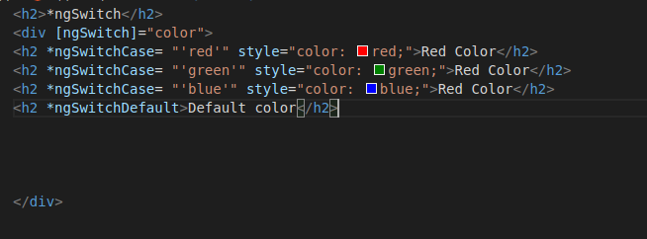
*ngSwitch (Angular part 2)

Slide 35
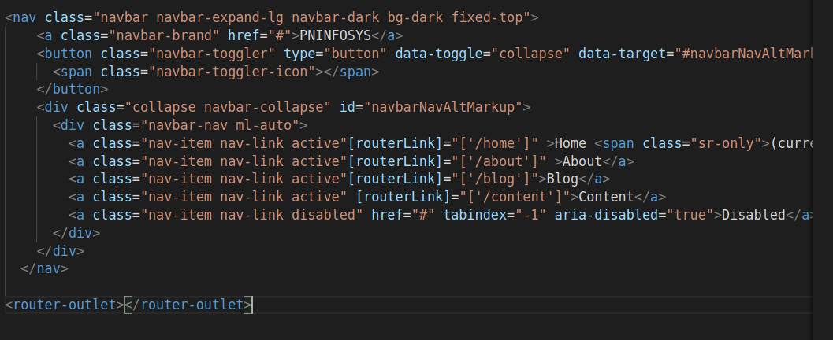
How to set Router Link in angular 9

Slide 36
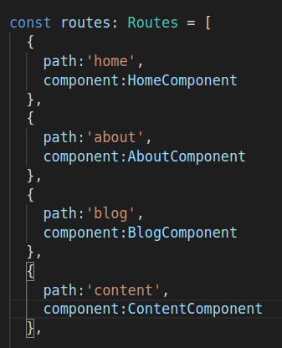
Router Link

Slide 37
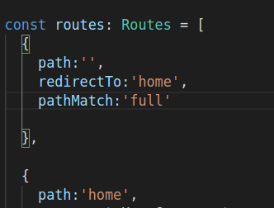
Redirecting Route

Slide 38
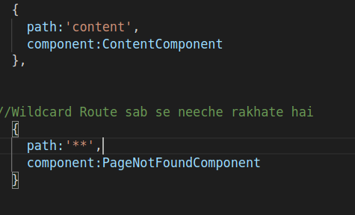
Wildcard Route
Ng g c pageNotFound

Slide 39
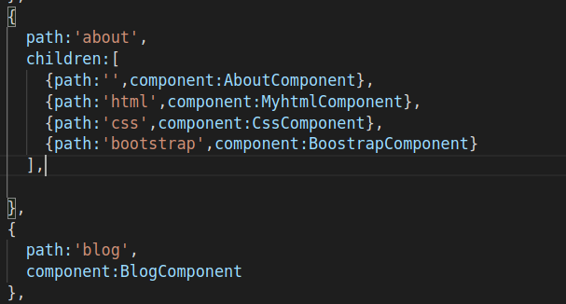
Set Child Route
Ng g c html,css,bootstrap

Slide 40
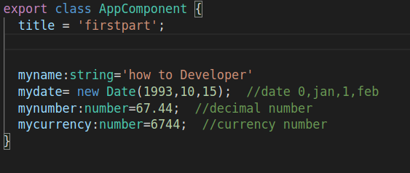
Pipe(data transform )

Slide 41
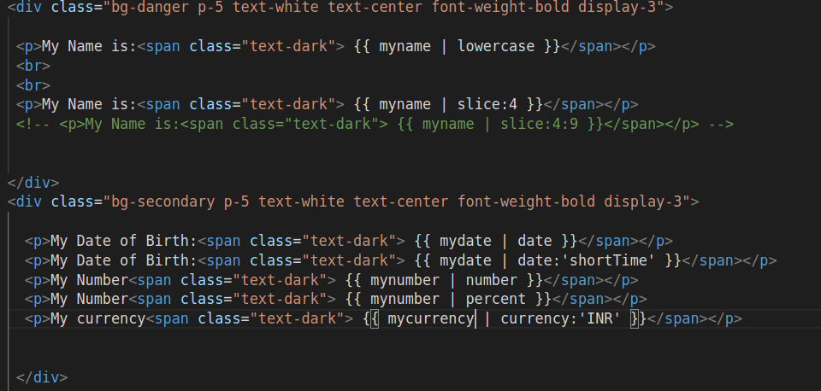
Pipes

Slide 42
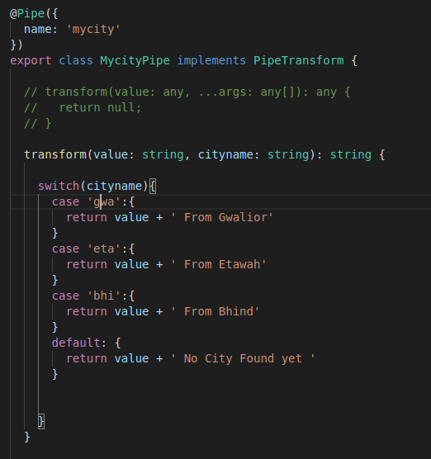
Custom Pipes
Ng g p mycity

Slide 43
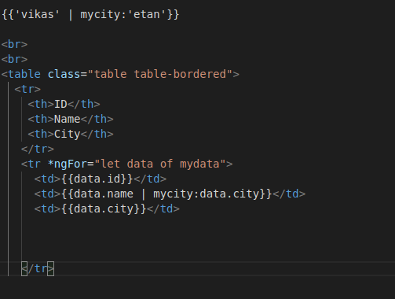

Slide 44
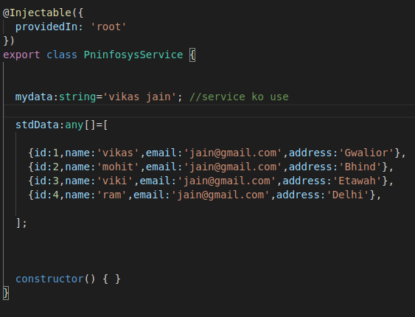
Service
Ng g s pninfosys

Slide 45
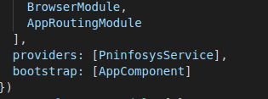
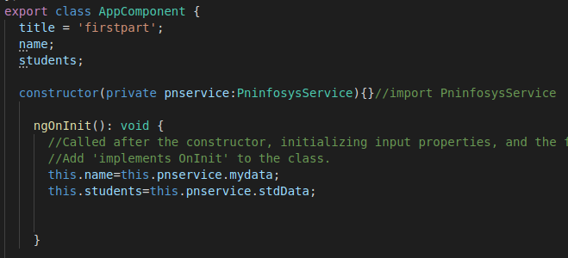

Slide 46
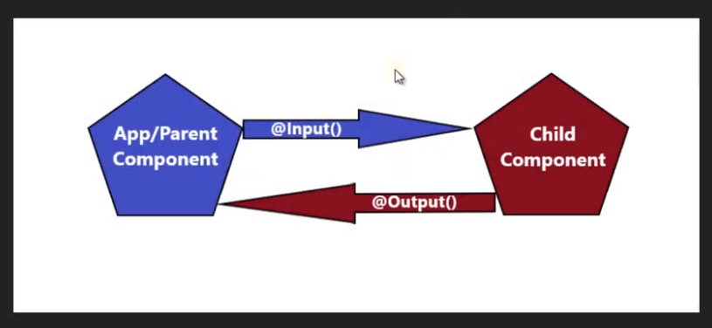
@Input and @output Property

Slide 47

@input

Slide 48


Slide 49


Slide 50


Pass data parent to child

Slide 51



Slide 52
@Output

Slide 53

Form

Slide 54


